Slide 1
Bible reading
Luke (ਲੂਕਾ) 24:50-53 &
Acts (ਰਸੂਲਾਂ ਦੇ ਕਰਤੱਬ) 1:9-12

Slide 2
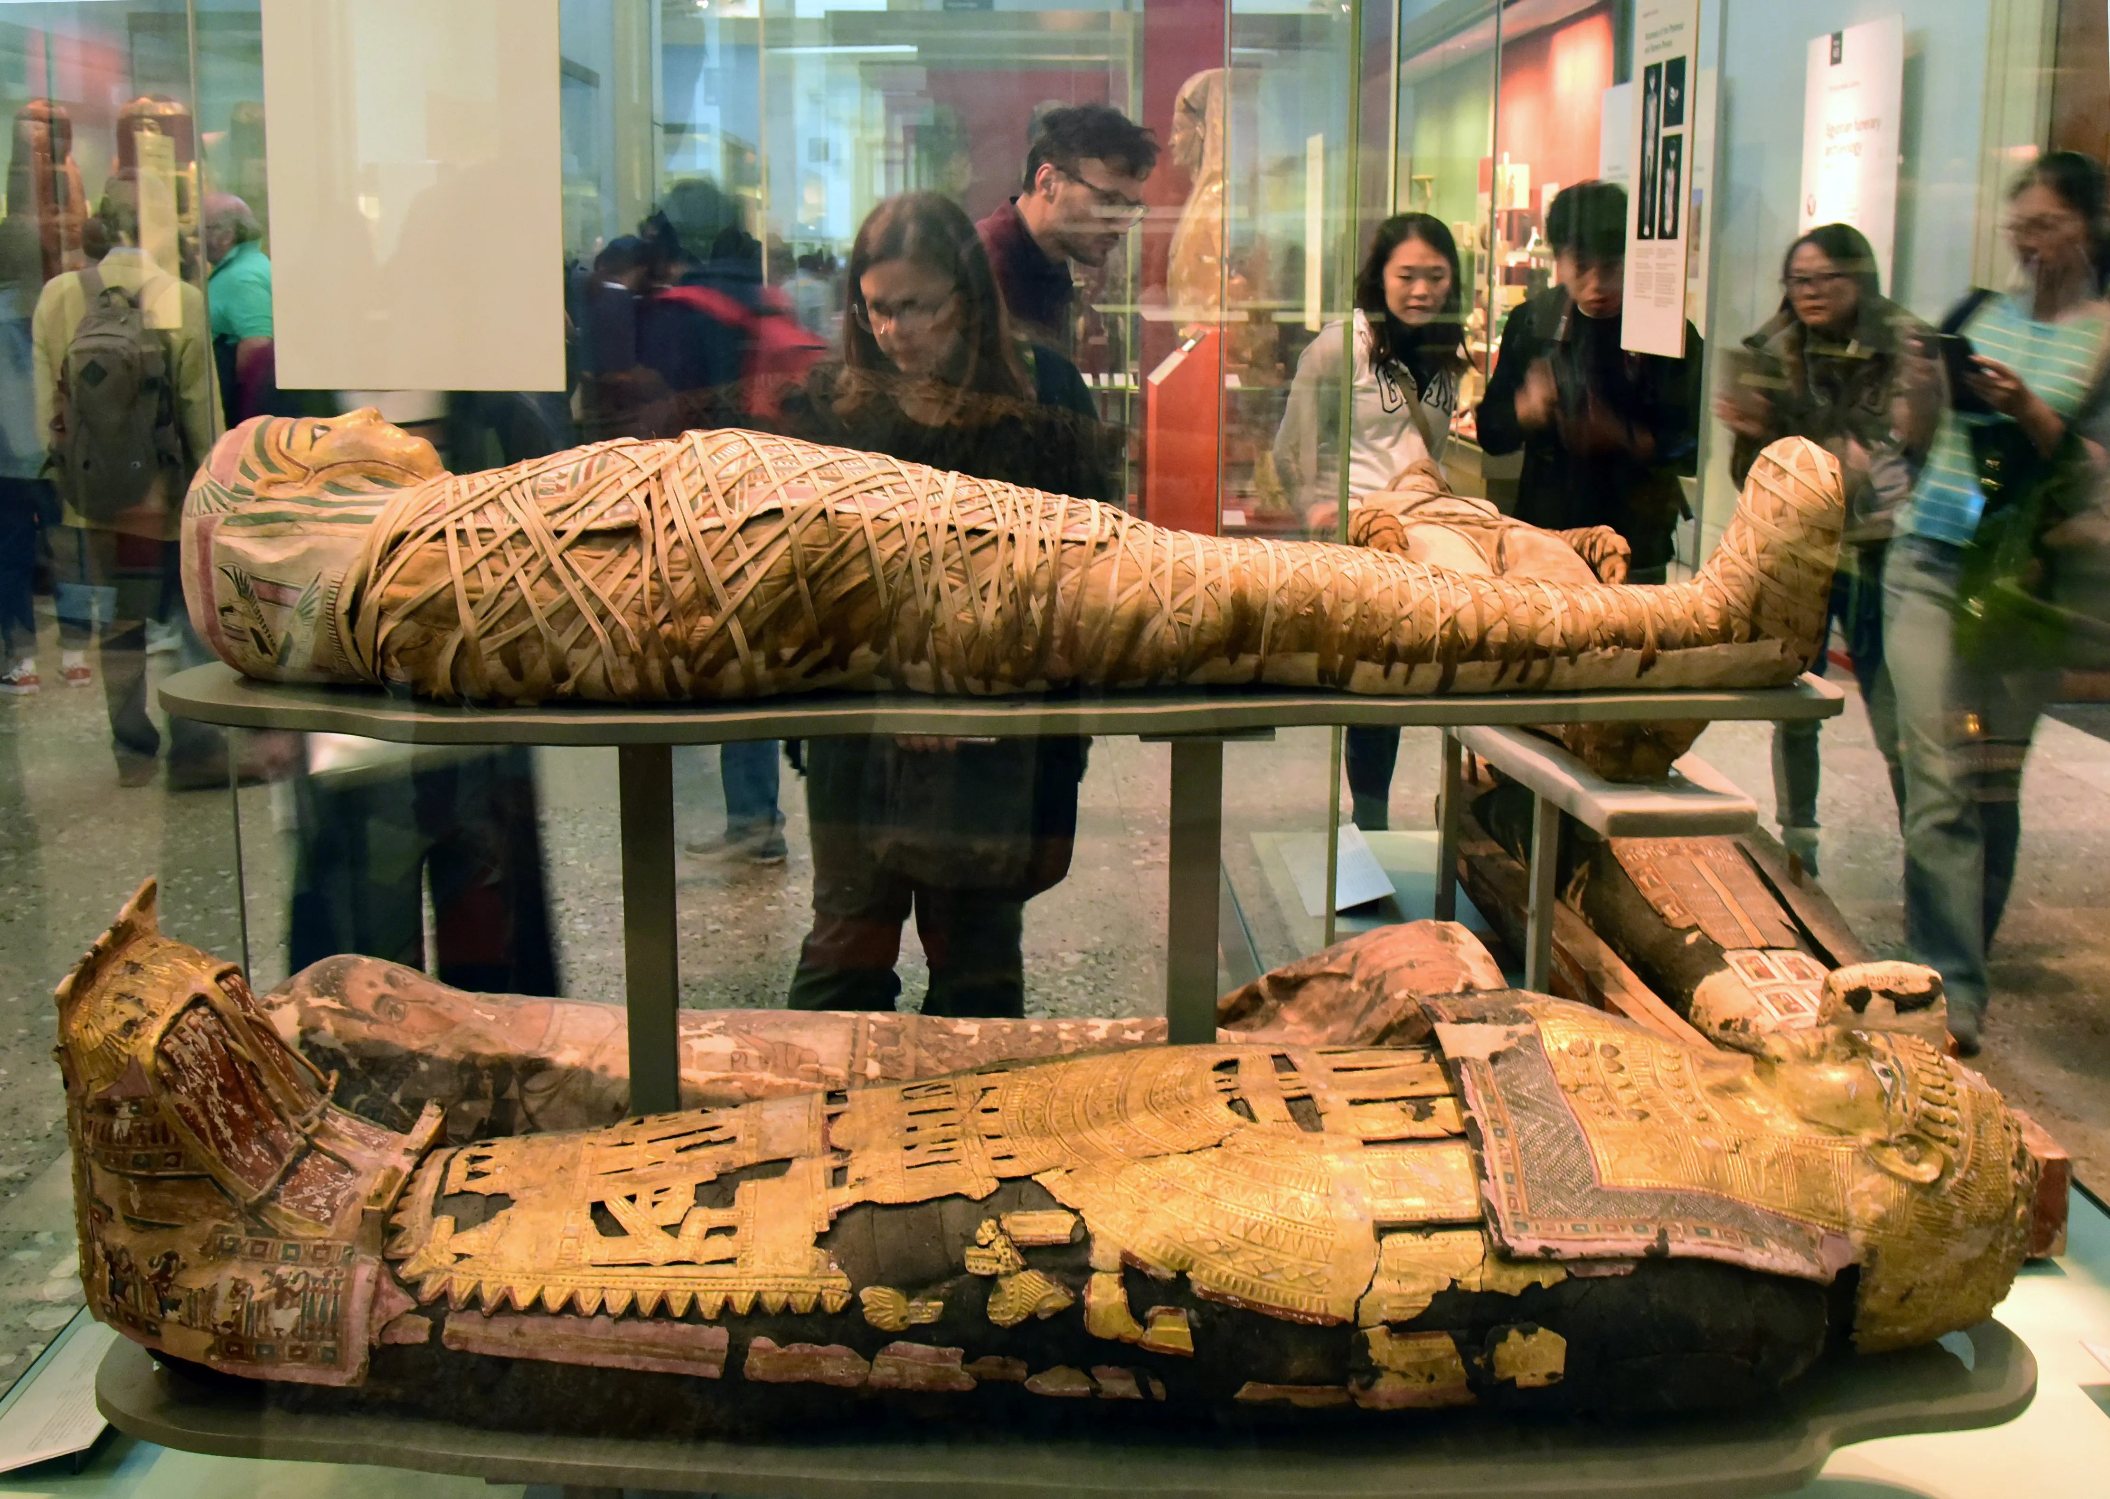
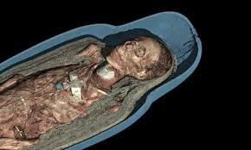
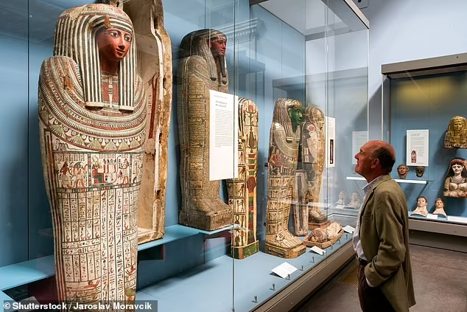

Slide 3
(1) The Ascension described(Luke 24:50-53 & Acts 1:9-12)
(2) The significance of the Ascension of Christ
Jesus’ ascension shows Christ received glory and honour that had not been His before (Eph 1:20-21, John 17:5, Rev 5)
Jesus’ ascension means we have an intercessor in heaven
(1 John 2:1)
Jesus’ ascension means we can enter the very presence of God (Hebrews 10:19-20)

Slide 4
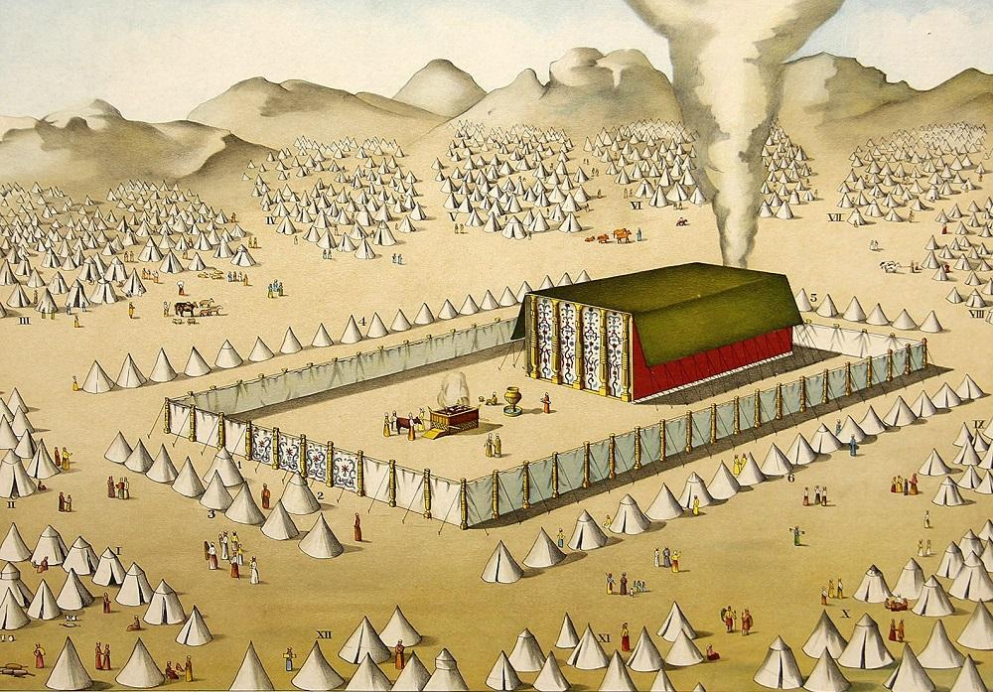
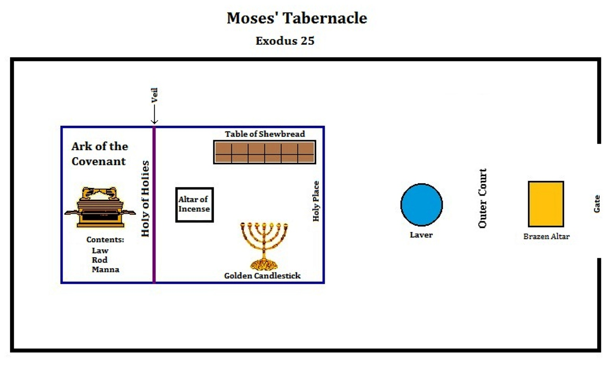

Slide 5
(2) The significance of the Ascension of Christ
Jesus’ ascension shows Christ received glory and honour that had not been His before (Eph 1:20-21, John 17:5, Rev 5)
Jesus’ ascension means we have an intercessor in heaven
(1 John 2:1)
Jesus’ ascension means we can enter the very presence of God (Hebrews 10:19-20)
Jesus’ ascension climaxes with Christ being seated at God’s right hand (Ephesians 1:20, Hebrews 1:3, 1 Peter 3:29)
Jesus’ ascension is something we can identify with (Eph 2:6)

