Slide 1
Bible Reading
Exodus 19

Slide 2
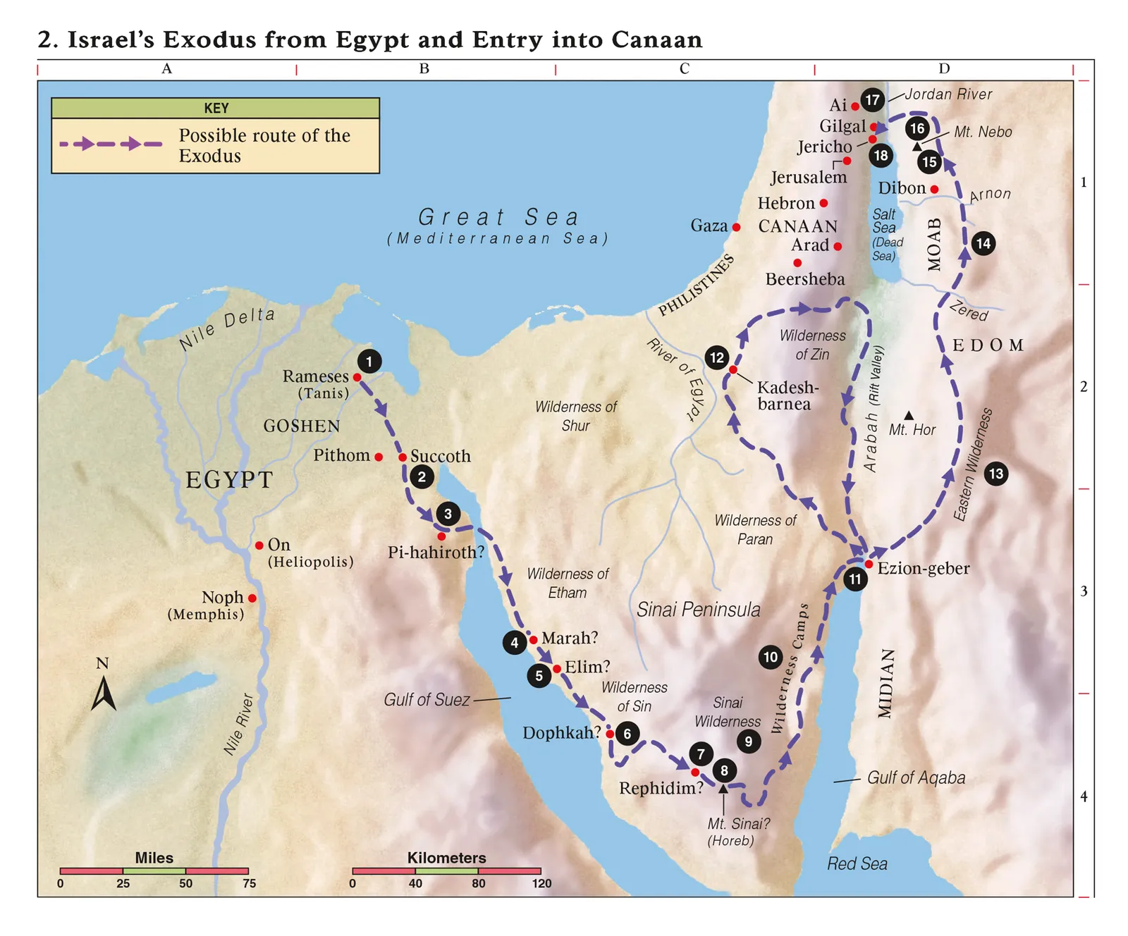

Slide 3
God fulfils His Word and keeps his promises
His presence – Hebrews 13:5 – I will never leave or forsake you
His protection – Gen 15:1 – I am your shield
His power – Isaiah 41:10 – I will strengthen you
His provision – Isaiah 41:10 – I will help you
His leading – John 10:4 – He goes before his sheep
His purposes – Jeremiah 20:11 God has a plan for us
His rest – Matt 11:28 – I will give you rest
His cleansing – 1 John 1:9 – If we confess sin, he forgives
His goodness - Psalm 84:11 – No good thing will he withhold from the upright
His faithfulness – Lamentation 3:23 – His mercies are new every morning
His guidance – Psalm 25:9 – The meek will he guide
His plan – Romans 8:28 – All things work for good

Slide 4
(2) God’s commands are a blessing not a curse
(3) God’s people are called to be holy
(4) God requires we come to Him through a mediator

